Slide 1

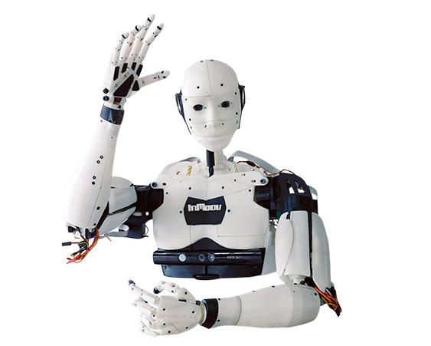



InMoov : Robot Interactif
Project Review

Slide 2
SUMMARY
InMoov : "Robot Intéractif"
Skills available
Team organization
Ressources available
Difficulties

Slide 3


InMoov : Interactive Robot
Goal : "Enable our humanoid to communicate with others."
Action
Response
Deep Learning

Slide 4
Are the subject and scope of the project stable?
Are the requirements for the project well understood?
Presenter le projet et son context. Quel est notre objectif (ecrit sur le papier au debut du projet) et comment on souhaite y parvenir (quelles solutions on a choisi) ?

Slide 5
Skills available
Does the project team have the technological skills to do the job?
Bases/connaissances en info
Soft skills
Profil de chacun (TimeKeeper : Coco, Animateur: Rabah , Leader :Rayan , Pousse-décisions:Kristof)

Slide 6

Team organization

Slide 7



Ressources and Means
DaVinciBot Support
IBM Workshop
Master Class IA and consulting
Own group research and online documentation
If the project uses new technology, is the new technology well understood and working?

Slide 8
Difficulties
If the project uses new technology, is the new technology well understood and working?
Trouver le temps pour le projet, 8-12h, mais pas suffisant, fragmenter entre l'apprentissage et la réalisation du projet
Apporter des solutions
Comment on utilise nos ressources pour avoir des solutions
Manque Données et matériels

Slide 9
Conclusion
Personality of the team
Improvement on the project
Reach our objectives

Slide 10
Thank you for your attention

